Slide 1
ADVANCED PATIENT HEALTH MONITORING SYSTEM USING PLCC TECHNOLOGY
GUIDE NAME
Ms.A.Nithya,.M.E.
TEAM MEMBERS
F.Darthi(211414205022)
K.Dhanusha(211414205025)
N.Gandhimathi Harini (211414205063)

Slide 2
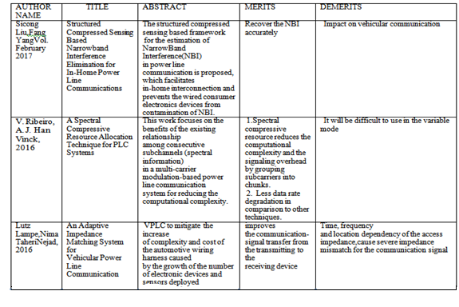
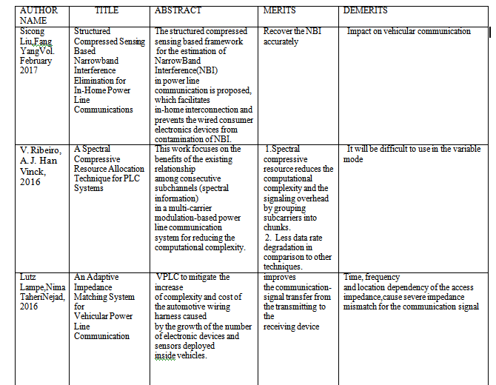
LITERATURE SURVEY

Slide 3
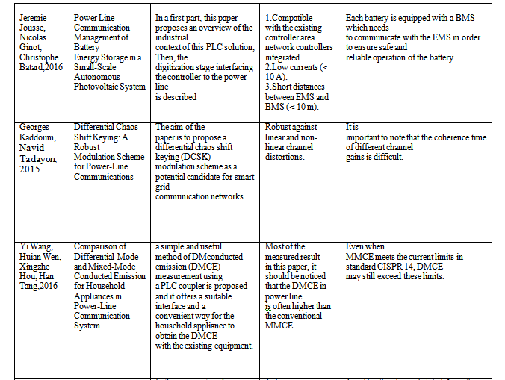

Slide 4
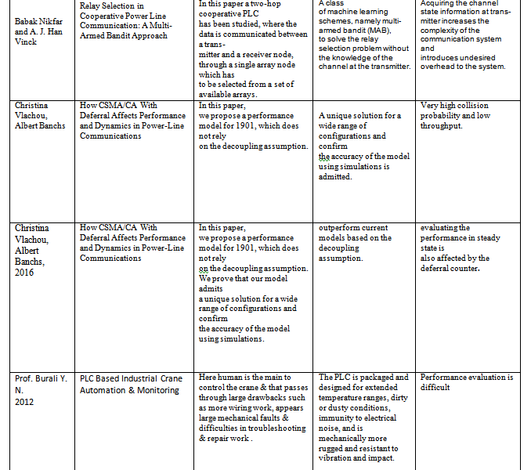

Slide 5
EXISTING SYSTEM
In hospitals, medical equipment like ECG machine, ventilators, infusion pumps, heart beat and blood pressure monitors are placed near the patients who need medical assistance.
The patient details are been monitored manually.
According to our literature survey, wireless communication like bluetooth, RF, Zigbee are implemented.
In wireless communication, we need to invest money for setting up the wireless communication channel. Also sometimes we face challenge of signal low strength and information loss during transmission.
Medical Intensive Care Unit (MICU) in some hospitals has automated patient monitoring system for their patient.
In some cases these automated units are interconnected by networking for central monitoring and medical data storage.

Slide 6
In an advance system till now the data communication is been done through external cables for communication between two nodes.
Using the external cables will increases the cost and need to maintain the server for data communication. So the end user has to provide maintenance cost.
Power losses is very high
Recent year’s communication technologies are applied in healthcare for performing surgery and delivering assistance to the patients in the form of tele-surgery, telemedicine, biotelemetry using LAN, Radio Frequency (RF), ZigBee, WAN etc.
Rural and urban sectors are targeted by the medical industries for assisting and delivering medical care.

Slide 7
PROPOSED SYSTEM
To overcome these problems the data communication will done through the power line system. It will reduce the cost.
The data will transfer with the EB power cable itself so that it will eliminate the needs of external devices.
Through PLC we can control and monitor the device.
It is efficient and power saving.
We proposed system to system communication using the existing power line EB cables.
In the proposed system, we propose power lines mode of transmitting data over 220V/50v) to control the electrical devices. These power line communication modem is used in which FSK [Frequency shift keying] is used for modulating the signal.

Slide 8
In the proposed system, we use medical sensors like heartbeat, blood pressure and temperature sensors which are been integrated with the patient and connected to the power supply (PLCC).
The patient data are transmitted to the monitoring session using power line cables which are been already existing.
In Proposed system we present a feasible patient monitoring System in which ubiquitous
Sensors connected to microcontroller via PLCC sends the data and in turn controls the devices.
There are Multiple receivers which contain the power line modem can be connected through the power line to the devices..
PIC controller and Real Time Operating system whereas embedded web server technology is the combination of embedded device and PLCC.

Slide 9
In the receiver end, we would be using java for data collection. The patient data are encrypted using AES encryption algorithm and stored in the public clouds.
For cloud storage we used public cloud named CloudMe.
Using PLCC it is possible to monitor patients remotely.
Thus our proposed system provides 2 monitoring sessions:
1. Java and 2. Cloud.
Thus providing the opportunity of monitoring the patient information internally using Java and remotely using IoT.
This paper presents a PC based temperature monitoring and control system using virtual instrumentation.
Temperature sensor measures the temperature and produce corresponding analog signal which is further processed by the microcontroller..
The data will be displayed on the LCD in microcontroller and PC monitor.
Monitoring and control can be done with the help of control circuitry.

Slide 10
SOFTWARE AND HARDWARE REQUIREMENTS:
HARDWARE REQUIREMENTS:
PIC microcontroller
Temperature sensor
Heart beat sensor
Pressure sensor
LCD
PLCC modem
Power supply
SOFTWARE REQUIREMENTS:
MPLAB IDE
Embedded C
NET BEANS - JAVA

Slide 11
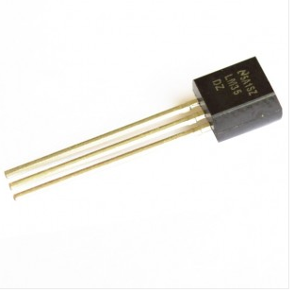
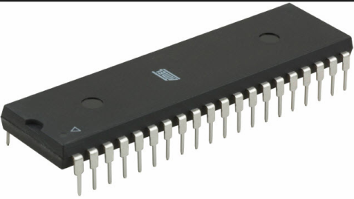
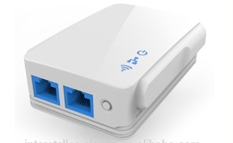
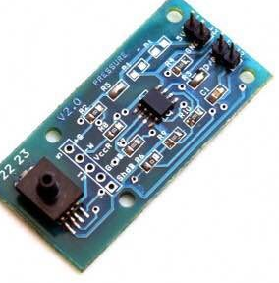
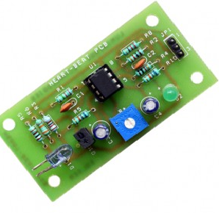
ARCHITECTURE DIAGRAM
TRANSMITTING SIDE:

Slide 12
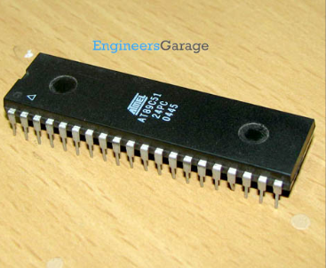



RECEIVING SIDE:

Slide 13
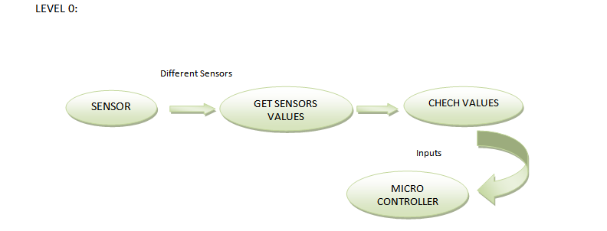
WORKFLOW:

Slide 14
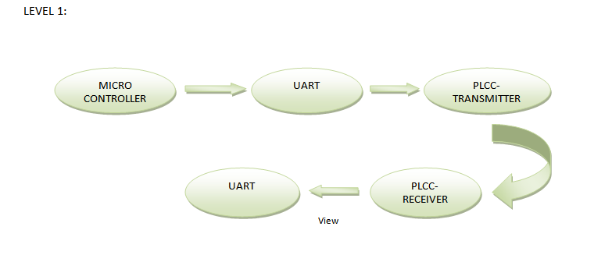
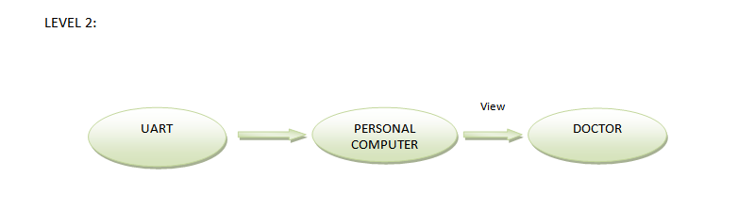

Slide 15
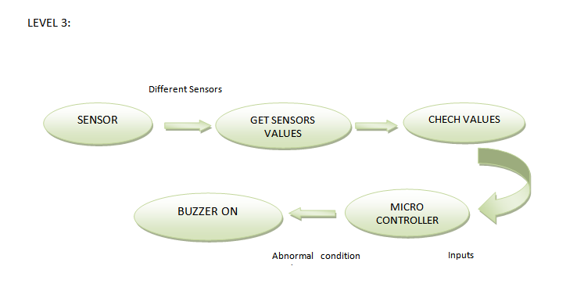

Slide 16
ALGORITHM/METHODOLOGY
Most AES calculations are done in a special finite field.
AES consists of several rounds of several processing steps that include substitution, transposition and mixing of the input plaintext and transform it into the final output of ciphertext.
The Advanced Encryption Standard (AES), also known as Rijndael (its original name), is a specification for the encryption of electronic data established by the U.S. National Institute of Standards and Technology (NIST) in 2001.
AES is a subset of the Rijndael cipherdeveloped by two Belgian cryptographers, Joan Daemen and Vincent Rijmen, who submitted a proposal to NIST during the AES selection process. Rijndael is a family of ciphers with different key and block sizes.
AES operates on a 4 × 4 column-major order matrix of bytes, termed the state, although some versions of Rijndael have a larger block size and have additional columns in the state. Most AES calculations are done in a special finite field.
AES consists of several rounds of several processing steps that include substitution, transposition and mixing of the input plaintext and transform it into the final output of ciphertext.

Slide 17
AES is an iterative rather than Feistel cipher. It is based on ‘substitution–permutation network’.
It comprises of a series of linked operations, some of which involve replacing inputs by specific outputs (substitutions) and others involve shuffling bits around (permutations).
Interestingly, AES performs all its computations on bytes rather than bits.
Hence, AES treats the 128 bits of a plaintext block as 16 bytes. These 16 bytes are arranged in four columns and four rows for processing as a matrix −
Unlike DES, the number of rounds in AES is variable and depends on the length of the key.
AES uses 10 rounds for 128-bit keys, 12 rounds for 192-bit keys and 14 rounds for 256-bit keys.
Each of these rounds uses a different 128-bit round key, which is calculated from the original AES key.

Slide 18
THE ENCRYPTION IN AES
The encryption process uses a set of specially derived keys called round keys.
These are applied, along with other operations, on an array of data that holds exactly one block of data-the data to be encrypted.
This array we call the state array.
You take the following aes steps of encryption for a 128-bit block:
1.Derive the set of round keys from the cipher key.
2.Initialize the state array with the block data (plaintext).
3.Add the initial round key to the starting state array.
4.Perform nine rounds of state manipulation.
5.Perform the tenth and final round of state manipulation.
6.Copy the final state array out as encrypted data (ciphertext)

Slide 19
AES : PSEUDOCODE
Cipher(byte in[16], byte out[16], key_array round_key[Nr+1])
begin
byte state[16];
state = in;
AddRoundKey(state, round_key[0]);
for i = 1 to Nr-1 stepsize 1 do
SubBytes(state);
ShiftRows(state);
MixColumns(state);
AddRoundKey(state, round_key[i]);
end for
SubBytes(state);
ShiftRows(state);
AddRoundKey(state, round_key[Nr]);
End

Slide 20
NOVELTY:
In our project we can transmit the patient data using powerlines which will be very useful since radiations from other wireless transmitters like wifi,zigbee may cause difference in details of patient parameters.
If any emergency the patient will be monitored immediately since the monitoring happens throughout the session by a monitorer and also the buzzer will alert the sorroundings.

Slide 21
MODULES SPLIT UP
Programming microcontroller
Power line communication
Data Collection using Java
Encryption
Interfacing Sensors
Internet of Things (IoT)

Slide 22
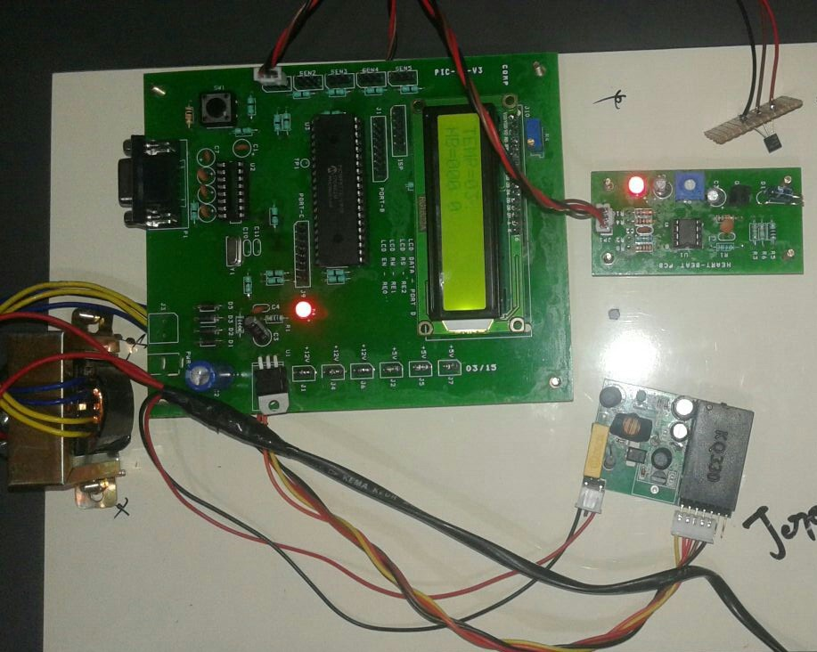
Transmitter Kit

Slide 23
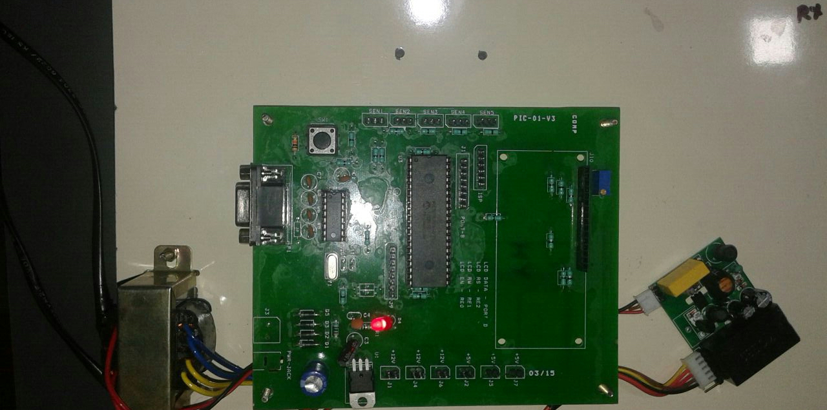
Receiver Kit

Slide 24
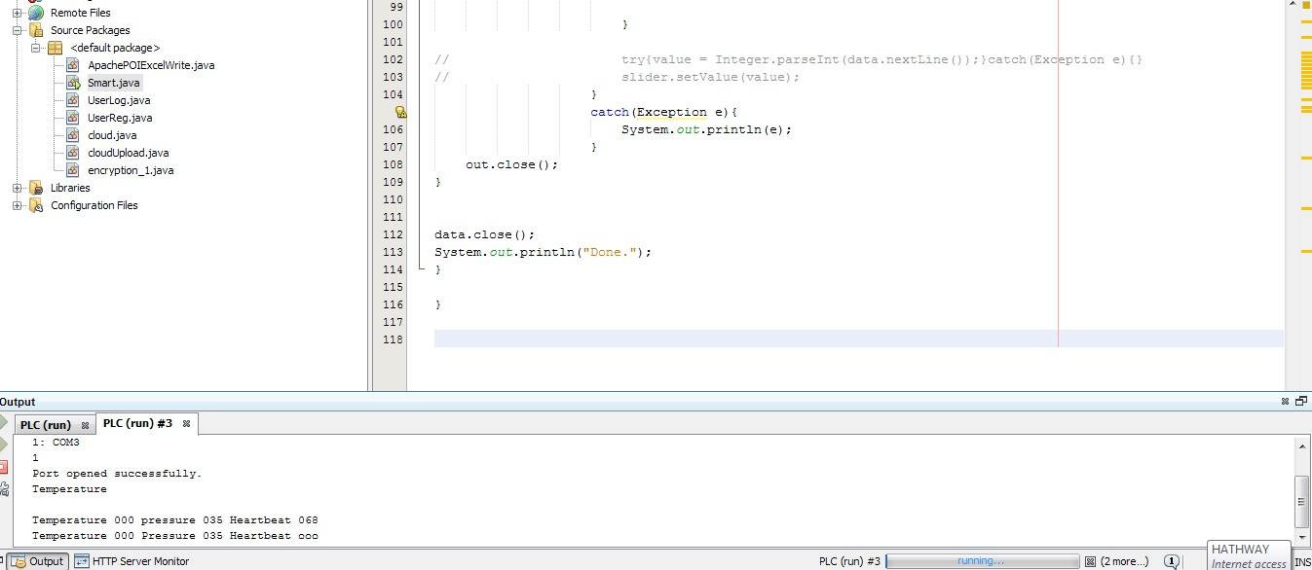
Getting Input Values from Serial Port

Slide 25
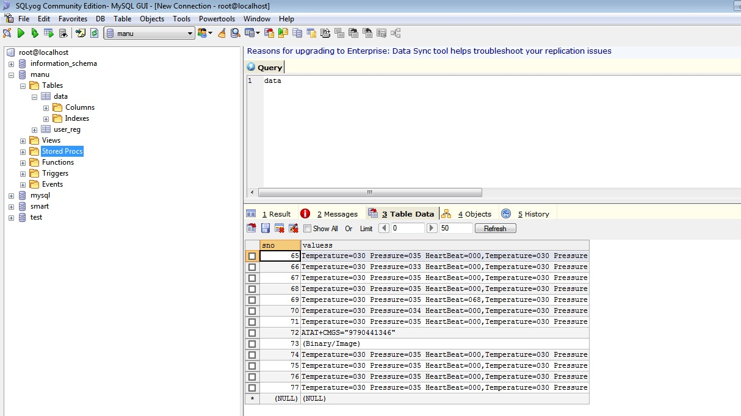
Values Stored in Database Using MYSQL

Slide 26
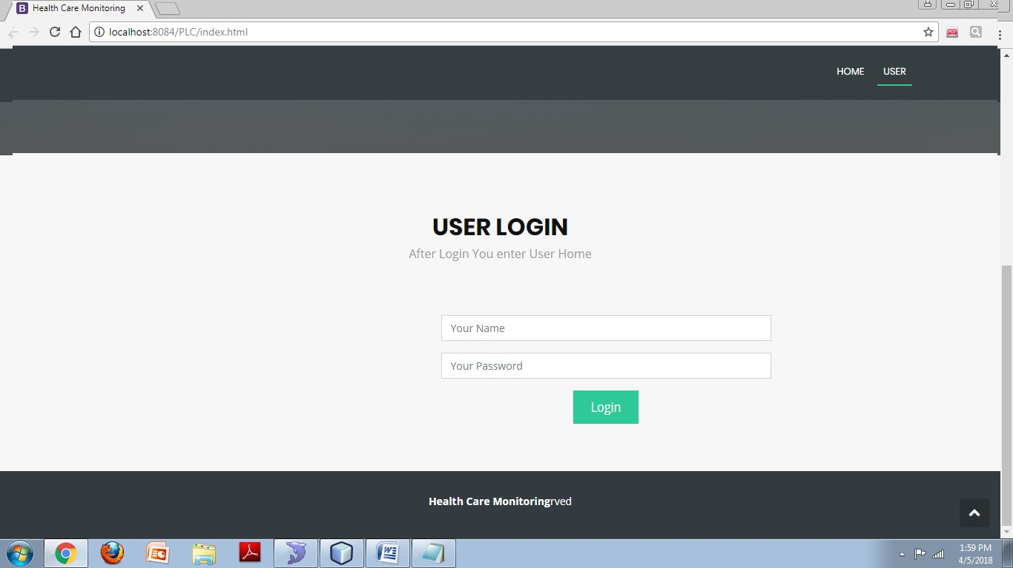
Login Process

Slide 27
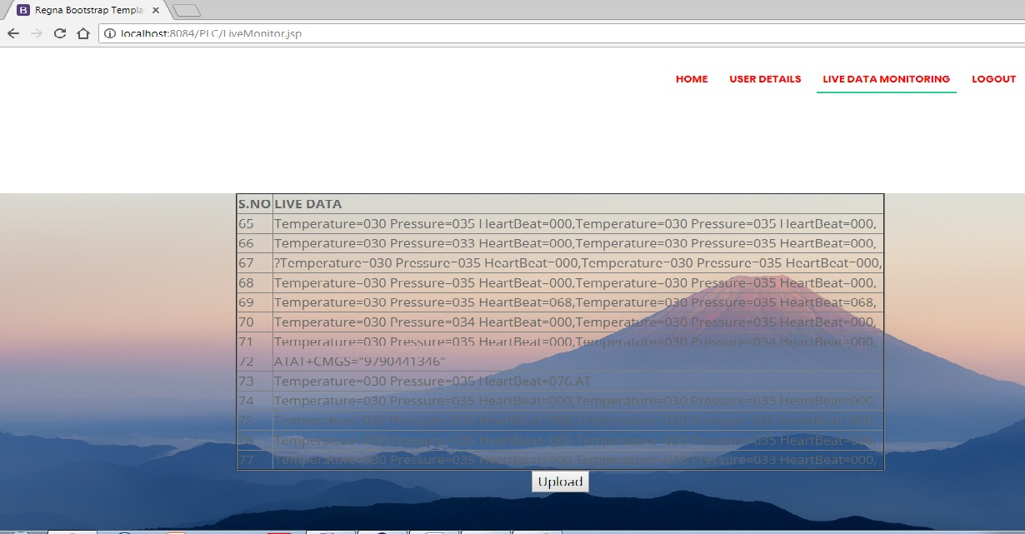
Live Data Monitoring

Slide 28
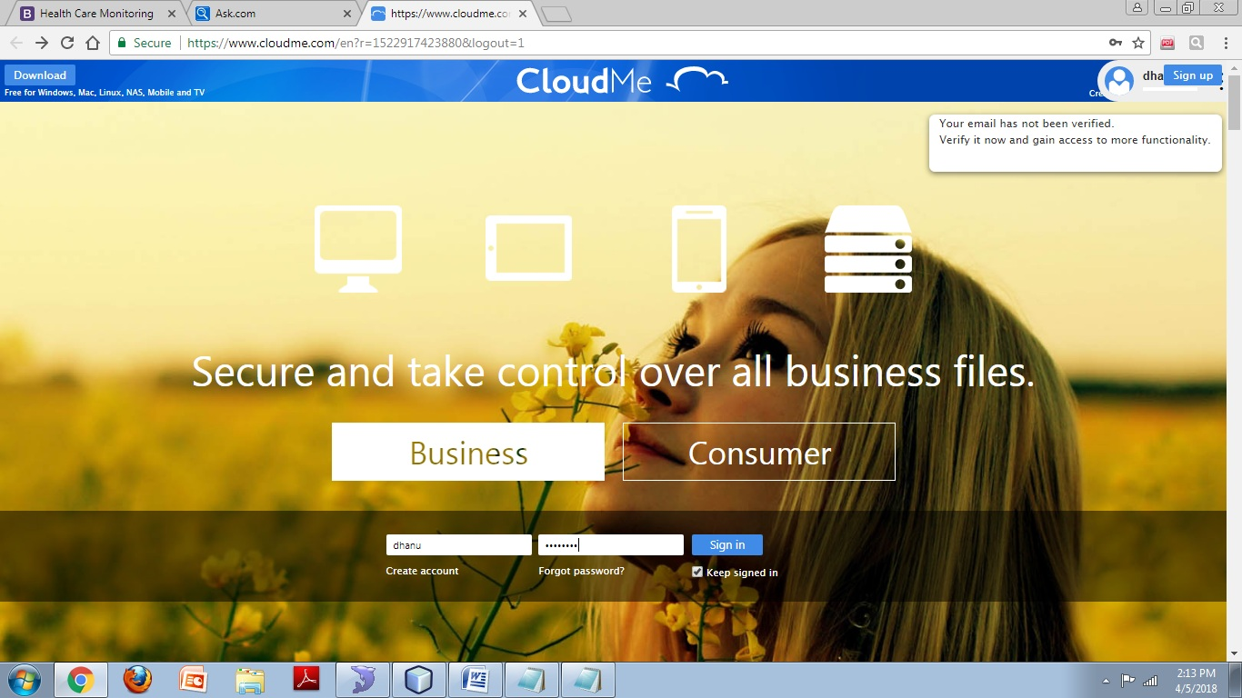
Cloud Login

Slide 29
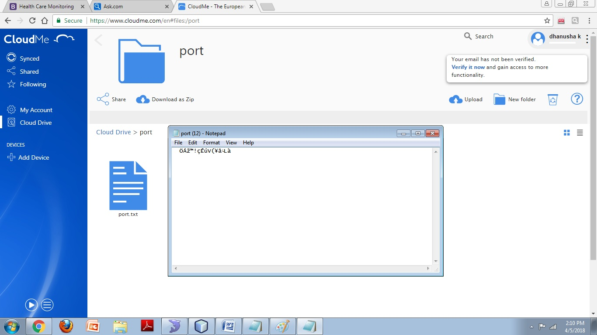
Data Encryption

Slide 30
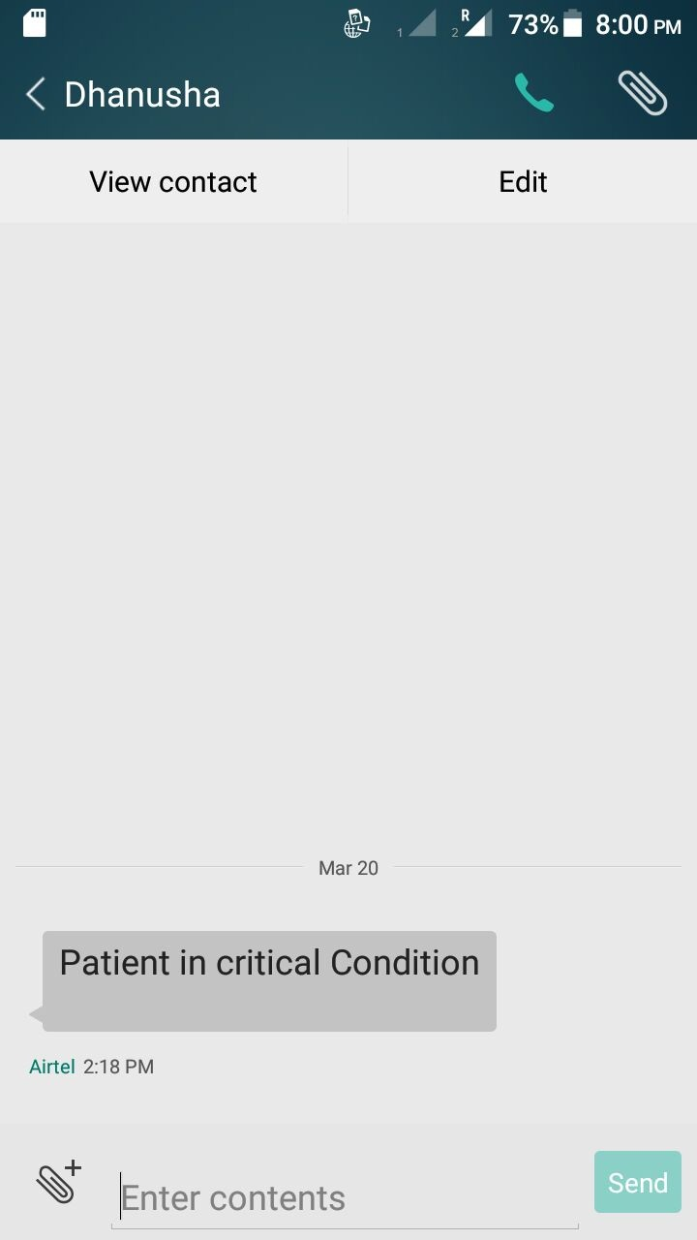
Alert Message to Phone

Slide 31
MODULE DESCRIPTION
Interfacing Sensors
Heart Rate Sensor The Heart Rate sensor monitors the light level transmitted through the vascular tissue of the fingertip and the corresponding variations in light intensities that occur as the blood volume change in the tissue.
Pressure Sensor This force sensitivity is optimized for use in human touch control of electronic devices such as automotive electronics, medical systems, and in industrial and robotics applications.
Temperature Sensor The measurement of temperature is one of the fundamental requirements for environmental control, as well as certain chemical, electrical and mechanical controls.
Get input values thru port
Analyse the input
Give it to PIC microcontroller

Slide 32
Programming microcontroller
A PIC microcontroller is a processor with built in memory and RAM and you can use it to control your projects (or build projects around it). So it saves you building a circuit that has separate external RAM,ROM and peripheral chips. It has many useful built in modules E.g. EEPROM, timers, Analogue comparators, UART.
Get input from sensors
Process inputs
Give it to PLC modem

Slide 33
Power Line Communication
PLC modems are used to make communication in power supply networks. Data signal from conventional communication devices, (computer, telephone) is converted by PLC modem in a form that is suitable for transmission over power lines.
PLC network produces electromagnetic radiation and disturb other services operating in the same frequency range.
Get input from PIC
Converted into a form suitable for power line transmission
Give it to PC

Slide 34
GSM
Global system for mobile communication(GSM) is a globally accepted standard for digital cellular communication.
GSM is the name of a standardization group established in 1982 to create a common European mobile telephone standard that would formulate specifications for a pan-European mobile cellular radio system operating at 900 MHz.
It is estimated that many countries outside of Europe will join the GSM partnership.
Get data from the PIC
Analyse the data
Give alert message to the base station

Slide 35
Data Collection using Java
API by Java developers, it still provides all the necessary functionality for proper serial communications.
In order to make the API portable across platforms, the API defines an abstract Serial Port class.
This class is then sub classed and platform specific functionality is implemented in the sub classed object.
Get data in PC
Process in NET BEANS IDE
Give it to cloud

Slide 36
Cloud Storage
CloudMe is a file storage service operated by CloudMe AB that offers cloud storage, file synchronization and client software.
It features a blue folder that appears on all devices with the same content, all files are synchronized between devices.
The CloudMe service is offered with a freemium business model and provides encrypted SSL connection with SSL Extended Validation Certificate.
Get input from netbeans
Upload to cloud
Store in cloud database

Slide 37
REFERENCE
[1] Xavier Carcelle,Power line communication in practice.
[2] ETSI, www.etsi.org/WebSite/Technologies/Powerline.aspx
[3] Galli, S., the Inter Inter-Co-PHY Protocol (IPP): A Simple Co Existence Protocol. IEEE International Symposium on Power Line Communications, Dresden, Germany, 31 March 2009.
[4] Galli, S. & Oleg, L., Recent developments in the standardization of power line communications in the IEEE. IEEE Communications Magazine, pp. 64–71, July 2008.
[5] Mains Network, http://en.wikipedia.org/wiki/Mains_network.

Slide 38
[6] IEEE P1901, Draft Standard for Broadband over Power Line Networks: Medium Access Control and Physical Layer Specifications, PUA and UPA contribution to IEEE 1901 call for submission on BPL access requirements Functional and Technical Requirements, pp. 1–41, February 2006. Online www.upaplc.org
[7] Sathya, R., Broadband over powerlines: a rapid way to join the knowledge society. Africa/Middle East Next Generation Network Summit, Johannesburg, South Africa, 17–19 February 2008. Online www.istpowernet.org
[8 ] PLC www.plcmanual.com/plc-programming
[9] Introduction to Programmable Controllers www.plcdev.com
[10] Library https://library.automationdirect.com/what-is-a-plc

